Slide 1
Unit I Introduction: Foundations and Evolution of Deep Learning
Dr. Sujit Das

Slide 2
What is Machine Learning
Machine learning (ML) is a branch of artificial intelligence (AI) focused on enabling computers and machines to imitate the way that humans learn, to perform tasks autonomously, and to improve their performance and accuracy through experience and exposure to more data.[ IBM]
Entities in Machine learning:
A decision Process
An Error Function
A model optimization Process

Slide 3
What is “Machine” in Machine Learning
The "machine" can be a variety of things, including:
Algorithms: Mathematical formulas and procedures that process data.
Software Systems: Complex programs designed to learn from data.
Physical Systems: In some cases, machine learning can be applied to physical systems, like robots, where the "machine" learns to adapt its actions based on sensory input.

Slide 4
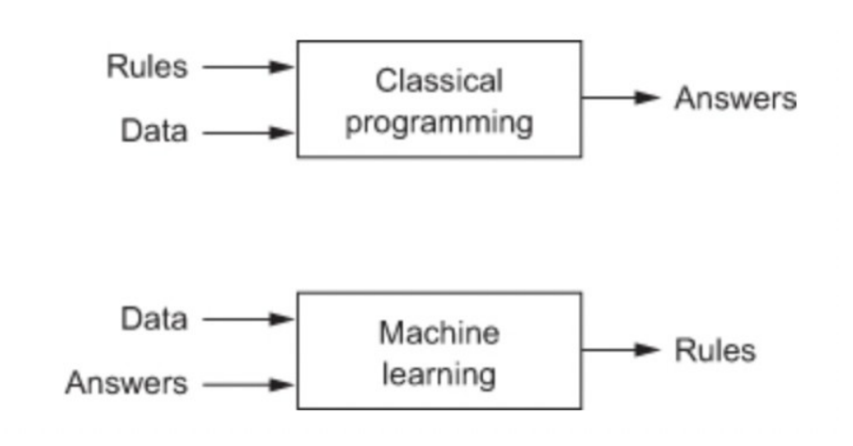
Programming Patterns

Slide 5
What is Deep Learning
Deep Learning is a subset of Machine Learning that uses mathematical functions to map the input to the output.
These functions can extract non-redundant information or patterns from the data, which enables them to form a relationship between the input and the output.
This is known as learning, and the process of learning is called training.

Slide 6
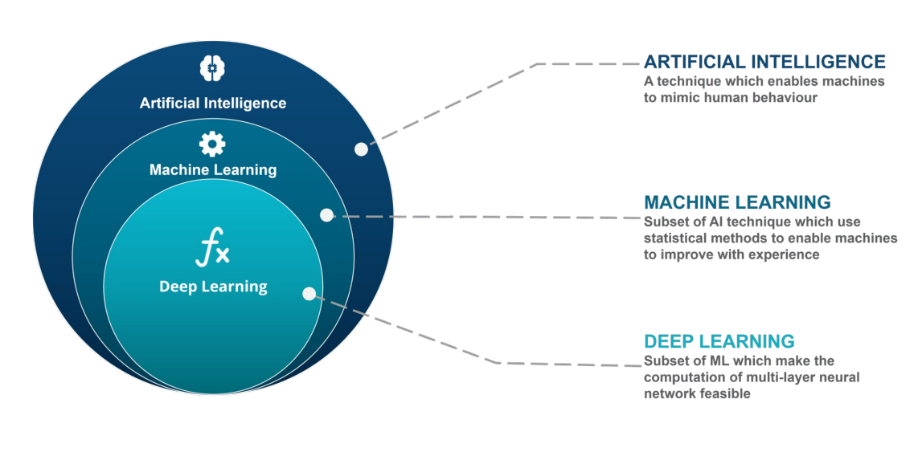
Deep Learning

Slide 7
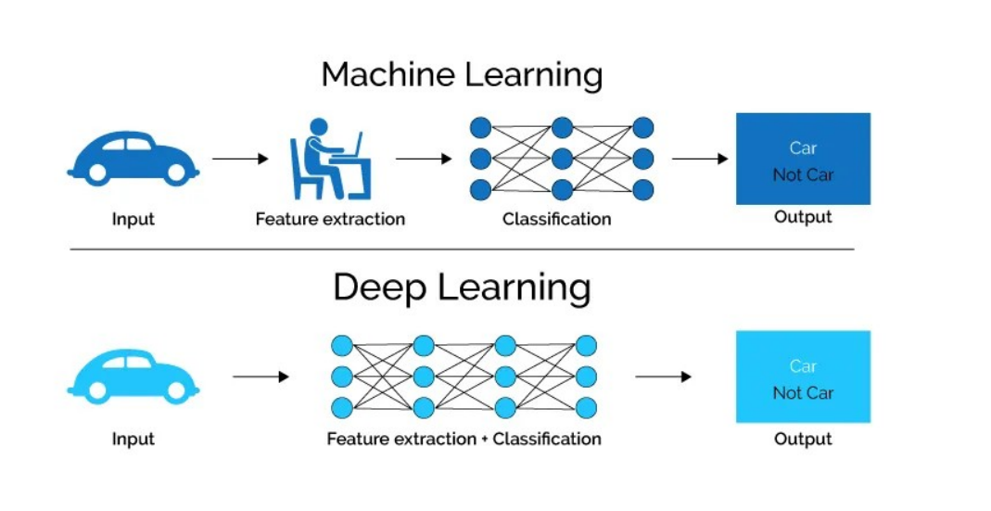
Deep Learning

Slide 8
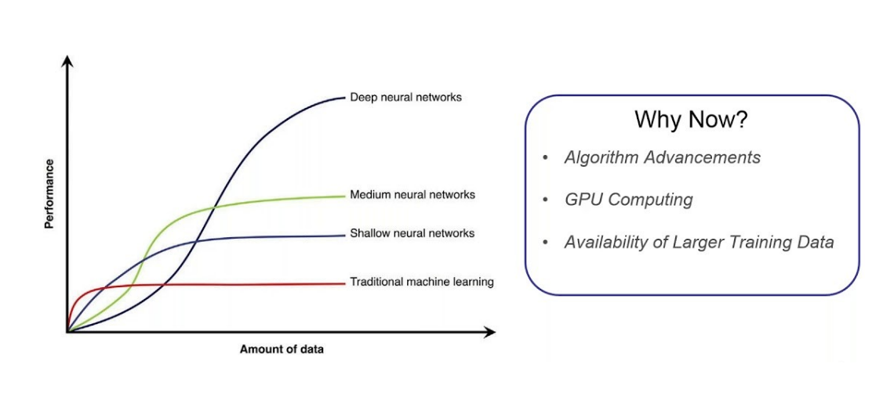
Why Deep Learning?

Slide 9
Historical Trends in Deep Learning
1943 – McCulloch & Pitts neuron model
1958 – Rosenblatt's Perceptron
1980s – Backpropagation & MLPs
1990s-2000s – CNNs, RNNs
2012+ – Deep Learning Renaissance (ImageNet, GPUs, Big Data)

Slide 10
1943 – McCulloch & Pitts Neuron Model
Key Contribution: Warren McCulloch (neuroscientist) and Walter Pitts (logician) proposed the first mathematical model of a biological neuron.
Model Highlights:
Binary input/output system.
A neuron fires (outputs 1) only if a weighted sum of inputs exceeds a threshold.
Implements basic logic gates like AND, OR, NOT.
Significance:
Laid the foundation for neural networks as logical computation systems.
Inspired the idea that the brain could be modeled mathematically.
Limitation:
No learning mechanism; hardcoded logic.

Slide 11
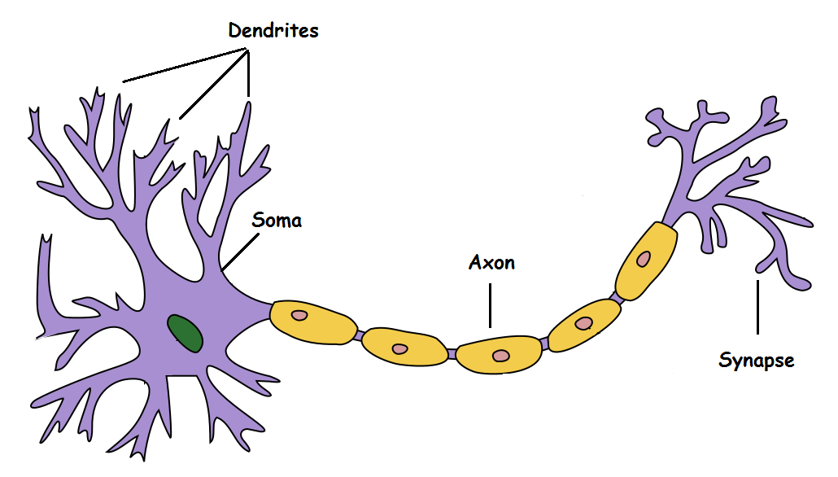
1943 – McCulloch & Pitts Neuron Model

Slide 12
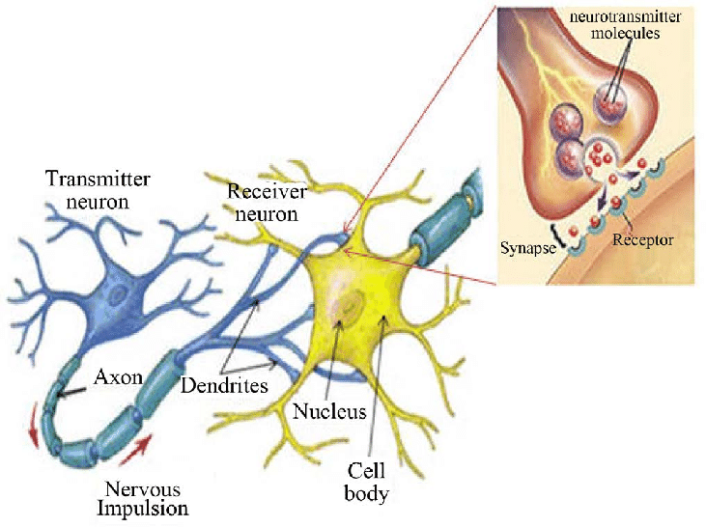
1943 – McCulloch & Pitts Neuron Model

Slide 13
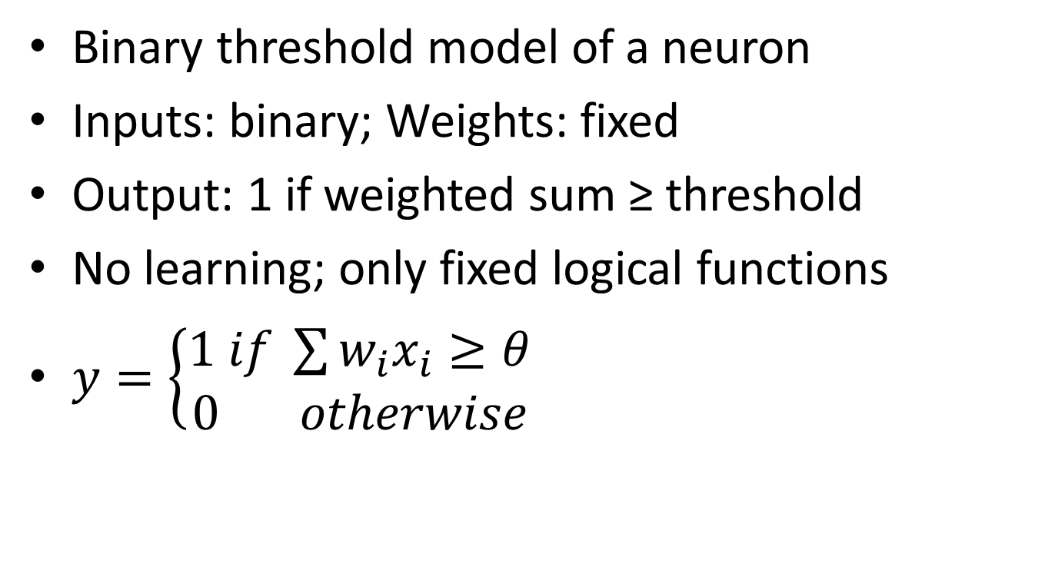
McCulloch-Pitts Neuron
Binary threshold model of a neuron
Inputs: binary; Weights: fixed
Output: 1 if weighted sum ≥ threshold
No learning; only fixed logical functions
$y=\left\{\begin{aligned}1 if \sum{w_{i}x_{i}≥θ} \\ 0 otherwise\end{aligned}\right.$

Slide 14
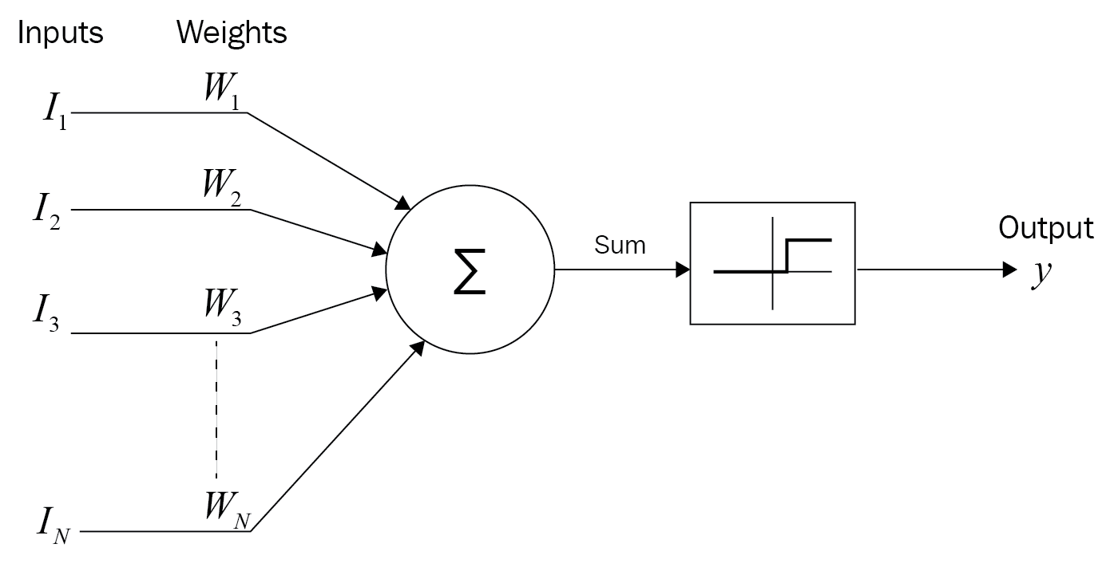
1943 – McCulloch & Pitts Neuron Model

Slide 15
1958 – Rosenblatt's Perceptron
Key Contribution: Frank Rosenblatt introduced the Perceptron, the first trainable artificial neuron.
Model Structure:
Weighted sum of inputs + bias.
Step activation function.
Simple learning algorithm to adjust weights using labeled data.
Significance:
Showed machines could learn from data.
Early success in pattern recognition tasks (e.g., letter recognition).
Limitation (highlighted in 1969 by Minsky & Papert):
Cannot solve non-linearly separable problems like XOR.
Caused a temporary decline in neural network research ("AI winter").

Slide 16
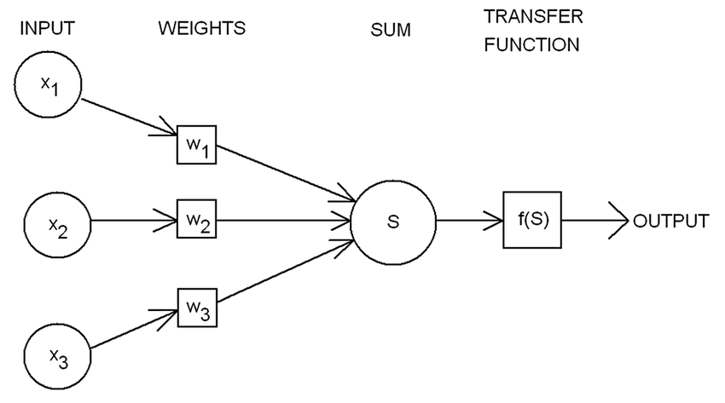
1958 – Rosenblatt's Perceptron

Slide 17
1980s – Backpropagation & MLPs
Key Contribution:
Backpropagation algorithm re-popularized by Rumelhart, Hinton, and Williams (1986).
Enabled training of multi-layer perceptrons (MLPs).
What Changed:
Backprop allowed gradients to be computed efficiently in deep networks.
Overcame Perceptron's limitations by stacking layers and using non-linear activations.
Impact:
Boosted interest in supervised learning.
Used in tasks like character recognition, speech classification.
Challenges:
Vanishing gradients, slow hardware, and small datasets limited scalability.

Slide 18
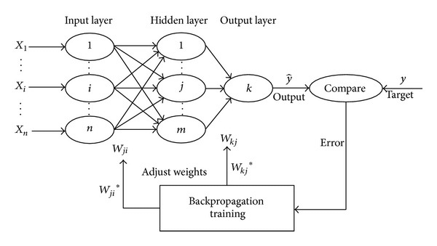
Backpropagation & MLPs

Slide 19
1990s–2000s – CNNs, RNNs
Key Innovations:
Convolutional Neural Networks (CNNs) by Yann LeCun (LeNet-5, 1998)
Used for handwritten digit recognition (MNIST).
Applied convolution + pooling layers for image processing.
Recurrent Neural Networks (RNNs) for sequential data (time series, language).
Developed by Elman and others.
Later improved with LSTM (Hochreiter & Schmidhuber, 1997) to handle long-term dependencies.
Why Important:
CNNs became the go-to for image data.
RNNs/LSTMs laid groundwork for language modeling, translation.
Challenges:
Training deep nets was still hard due to compute and data limitations.

Slide 20
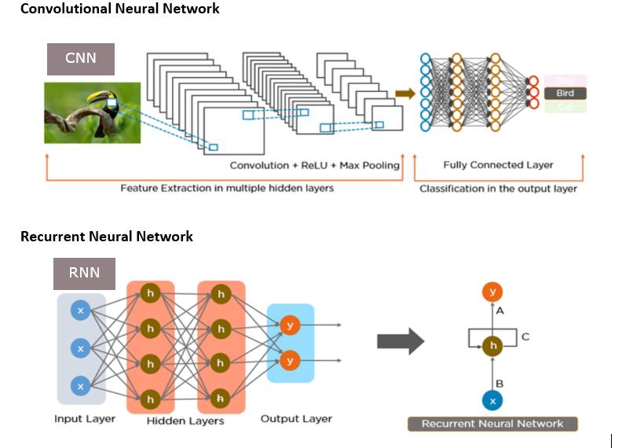
1990s–2000s – CNNs, RNNs

Slide 21
2012+ – Deep Learning Renaissance
Turning Point:
ImageNet Challenge (2012): AlexNet (Krizhevsky, Hinton, Sutskever) beat all previous models by a large margin using a deep CNN and GPU acceleration.
Catalysts:
Big Data: Massive labeled datasets like ImageNet.
GPU acceleration: Faster training.
Improved architectures: ReLU, Dropout, BatchNorm, ResNet, etc.
Open-source ecosystems: TensorFlow, PyTorch.
Impact:
Deep learning became state-of-the-art in:
Computer vision
Speech recognition
Natural Language Processing (NLP)
Recommendation systems
Modern Era:
Transformers (Attention-based models, 2017+)
Foundation models (GPT, BERT, etc.)
Real-world applications: autonomous driving, healthcare AI, generative AI.

Slide 22
Threshold Logic
Definition: Binary decision based on thresholded input
Functions possible: AND, OR, NOT
Limitation: Cannot model XOR
Basis of early neural computing logic

Slide 23
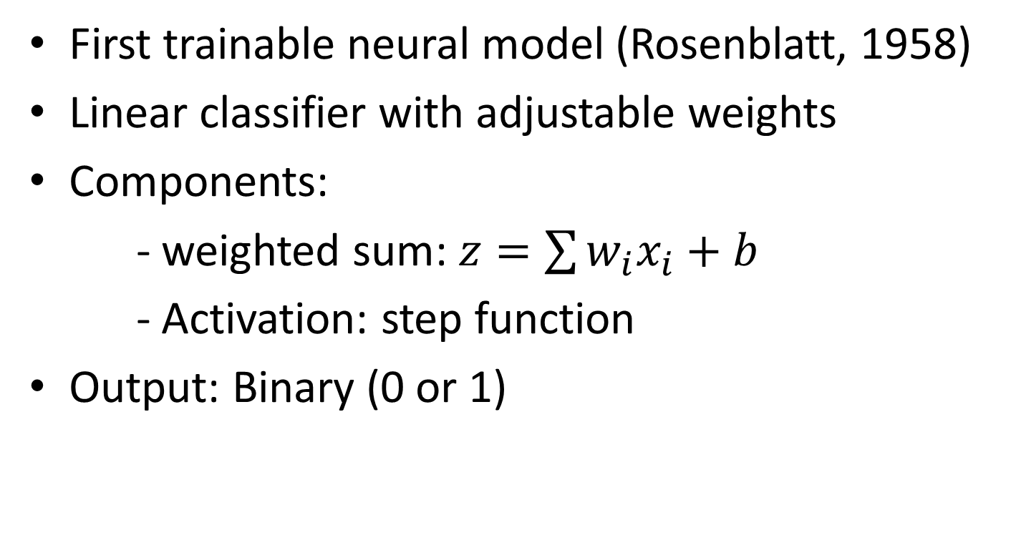
Perceptron
First trainable neural model (Rosenblatt, 1958)
Linear classifier with adjustable weights
Components:
- weighted sum: $z=\sum{w_{i}x_{i}+b}$
- Activation: step function
Output: Binary (0 or 1)

Slide 24
1958 – Rosenblatt's Perceptron

Slide 25
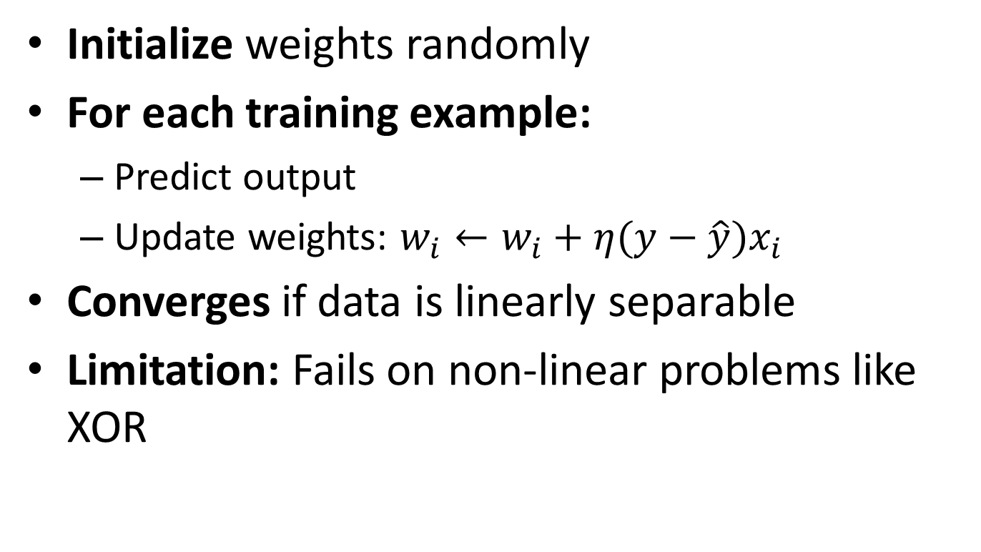
Perceptron Learning Algorithm
Initialize weights randomly
For each training example:
Predict output
Update weights: $w_{i}←w_{i}+η(y−\hat{y})x_{i}$
Converges if data is linearly separable
Limitation: Fails on non-linear problems like XOR

Slide 26
Representation Power of MLPs
MLPs = Multiple Layers of Perceptrons
With non-linear activation → can represent any function
Universal Approximation Theorem:
1 hidden layer → any continuous function
Deeper = more efficient representation

Slide 27
Data Normalization
Data normalization is the process of transforming data into a standard format or range, making it consistent and easier to analyze or use in machine learning models.
The primary goal is to ensure that different features (variables) contribute equally to the result, especially when they are measured on different scales.

Slide 28
Why Normalize Data?
Prevents dominance of larger-scale features: Features with larger ranges (e.g., income in thousands vs. age in years) can disproportionately influence the model.
Improves convergence in ML models: Algorithms like gradient descent converge faster when data is normalized.
Required by many algorithms: Some models (e.g., SVM, k-NN, neural networks) assume normalized data for optimal performance.

Slide 29
Data Normalization: Example
Suppose you have the following data:
Feature:
Salary [30,000, 60,000, 90,000]
Age [25, 35, 45]
Without normalization, Salary could dominate because it has a much larger scale than Age.
Using Min-Max Normalization:
Salary_norm = [(x - 30000)/(90000 - 30000)] = [0, 0.5, 1]
Age_norm = [(x - 25)/(45 - 25)] = [0, 0.5, 1]
Now both features are on the same scale.

Slide 30
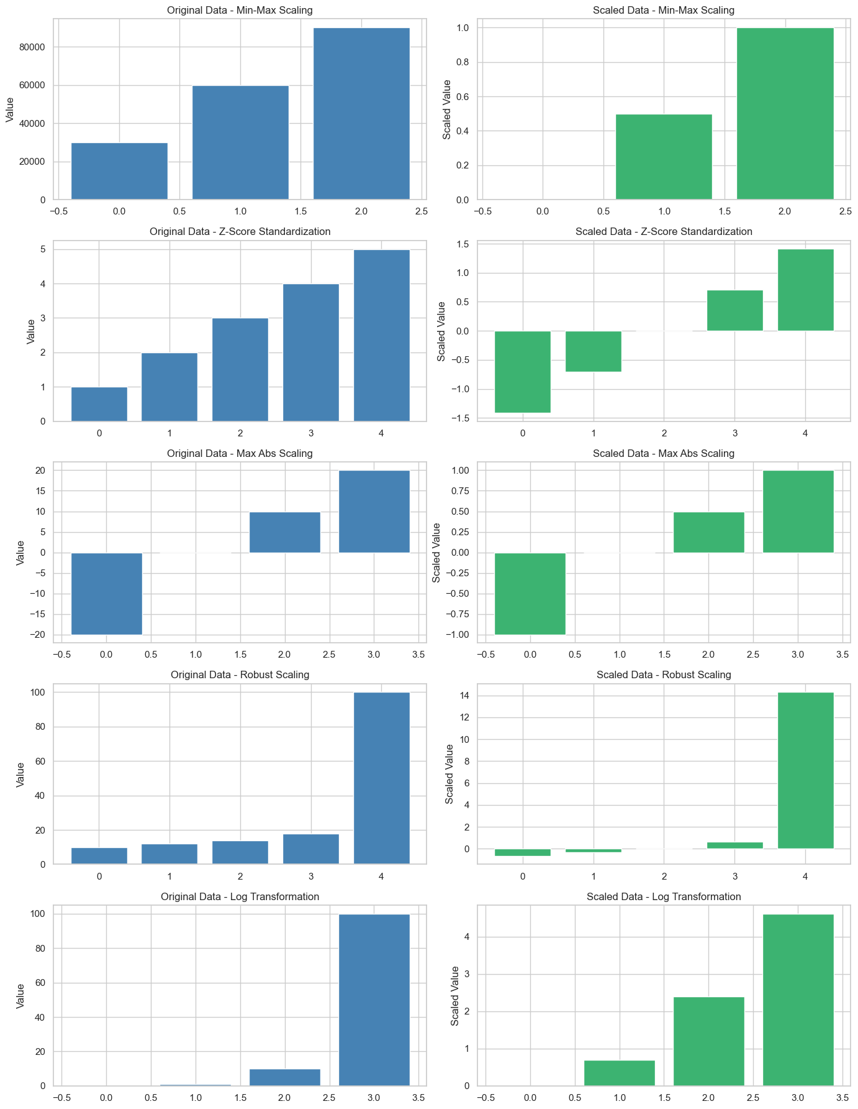

Slide 31
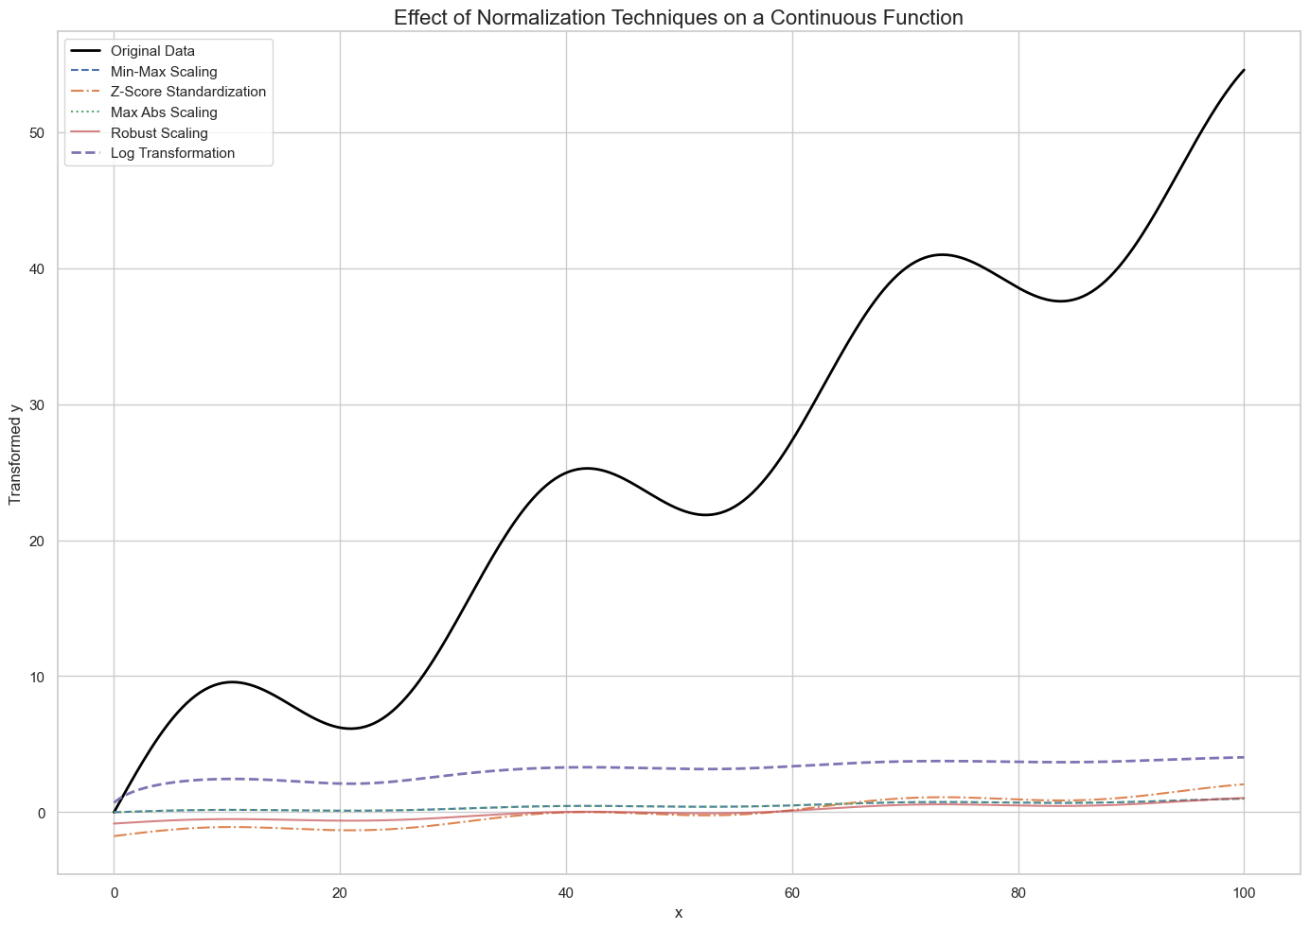

Slide 32
When to Normalize
Required for distance-based algorithms: k-NN, k-Means, SVM
Helpful for gradient-based models: Neural Networks
Not necessary for: Tree-based models (e.g., Decision Trees, Random Forests)

Slide 33
Activation Functions
An activation function is a mathematical function used in artificial neural networks (ANNs) to determine whether a neuron should be "activated" or not.

Slide 34
Why is activation function important?
It introduces non-linearity into the network, allowing it to:
Learn complex patterns
Approximate any function (thanks to the Universal Approximation Theorem)
Make decisions based on weighted input
“Without activation functions, the network would just be a linear model, no matter how many layers it had.”

Slide 35
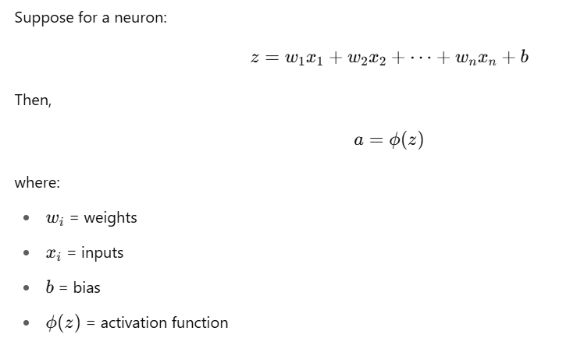
Activation Function: A mathematical View

Slide 36
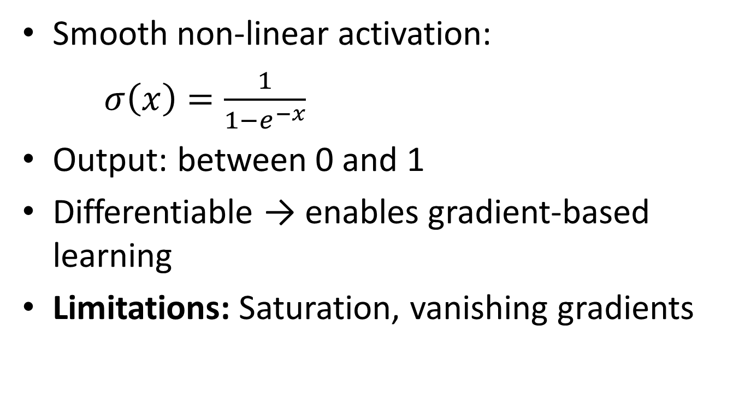
Sigmoid Neurons
Smooth non-linear activation:
$σ\left(x\right)=\frac{1}{1−e^{−x}}$
Output: between 0 and 1
Differentiable → enables gradient-based learning
Limitations: Saturation, vanishing gradients

Slide 37
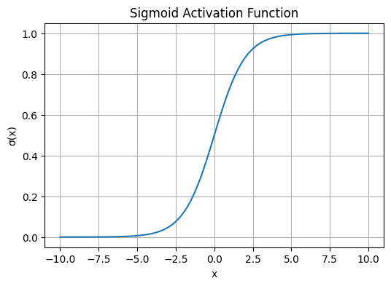
Activation Function

Slide 38
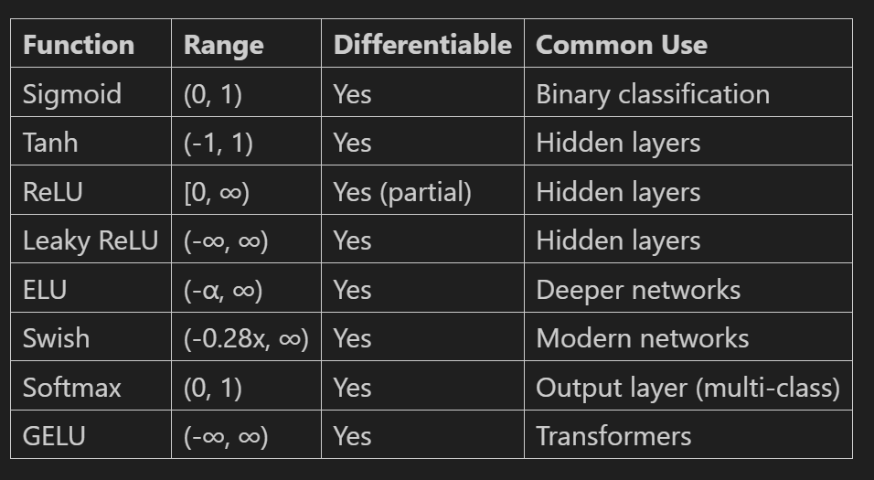

Slide 39
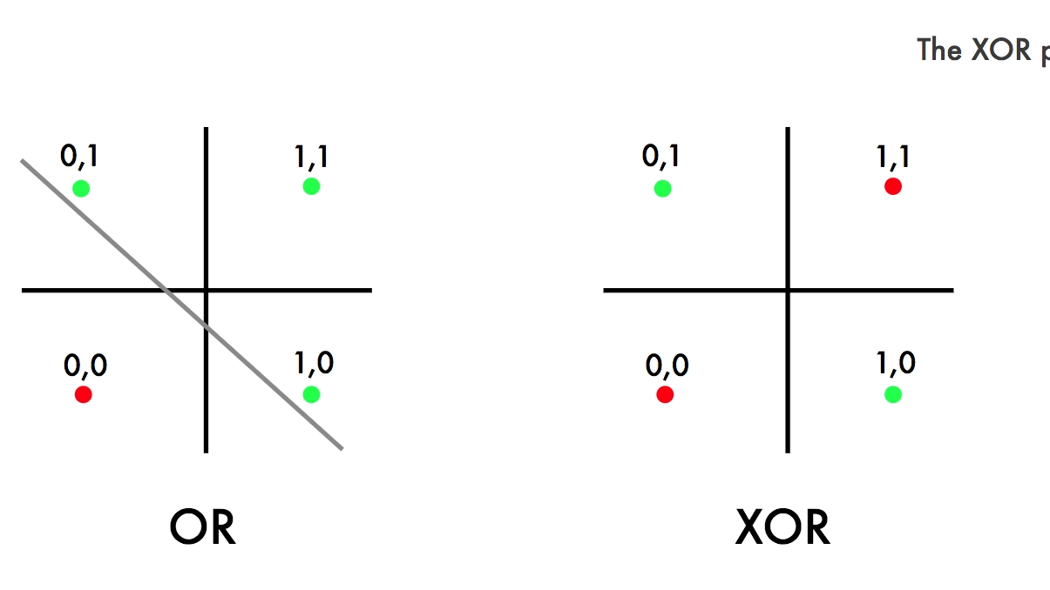
XOR Problem

Slide 40
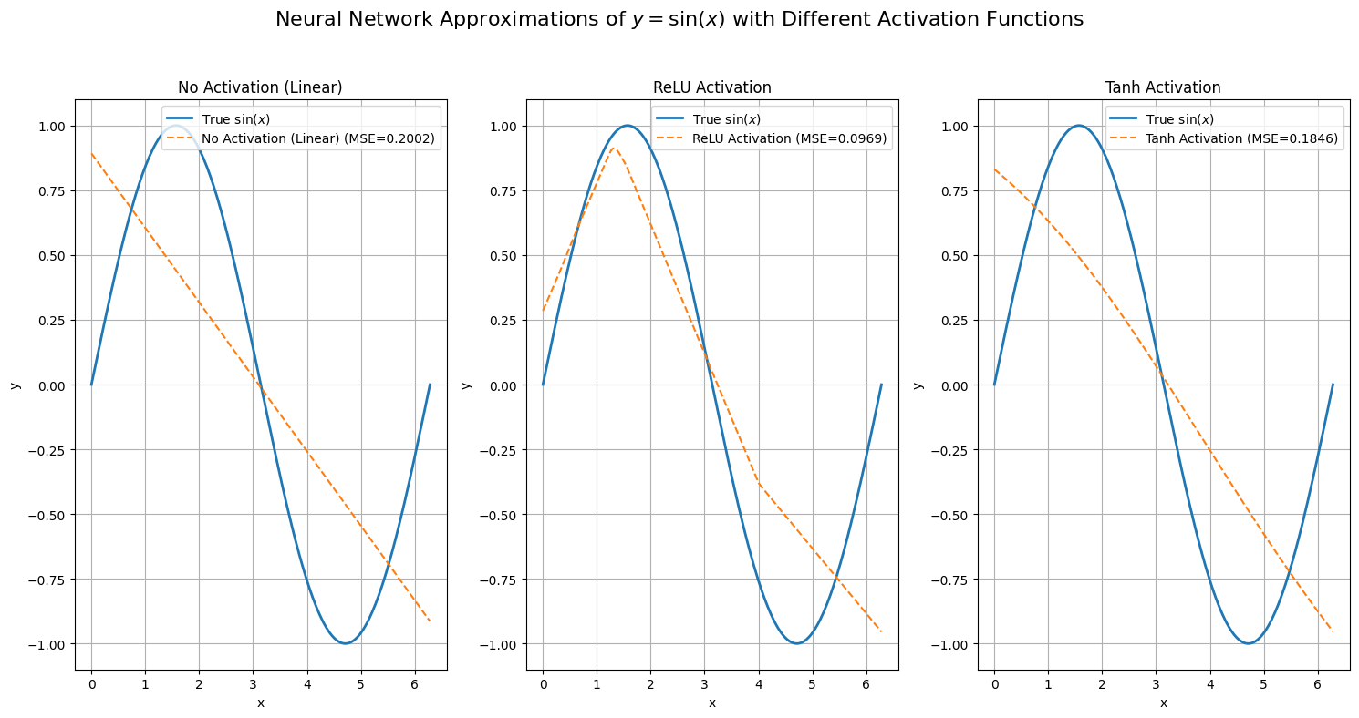

Slide 41
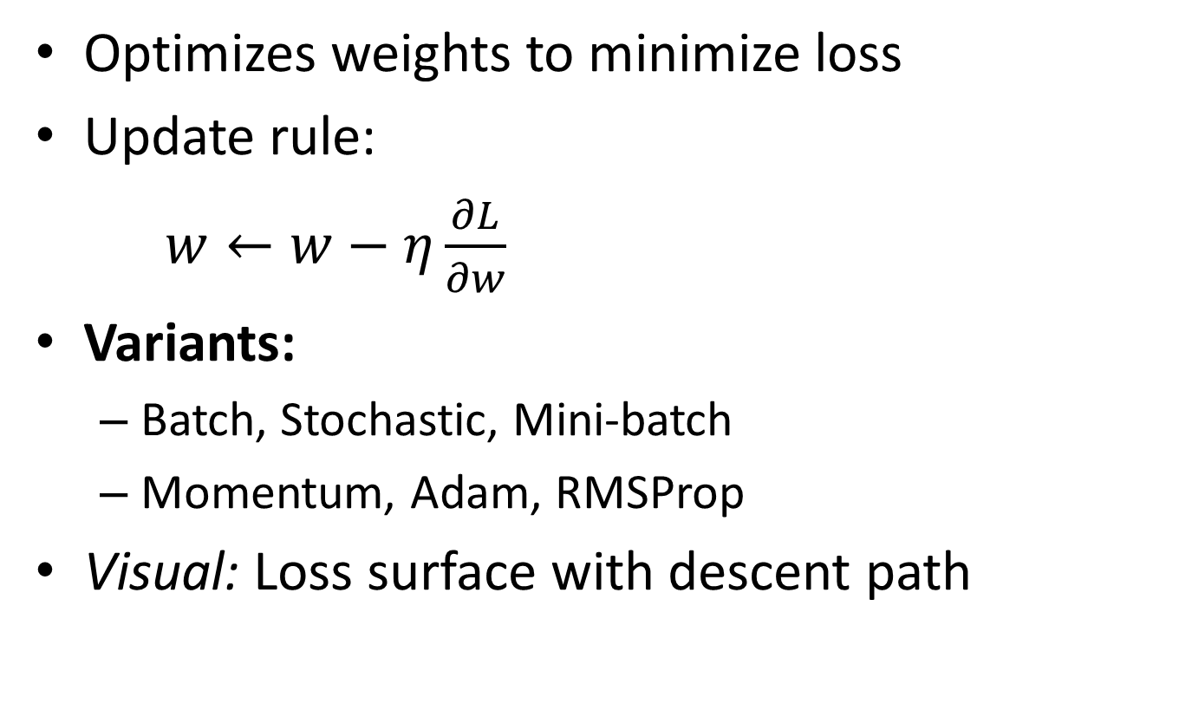
Gradient Descent
Optimizes weights to minimize loss
Update rule:
$w←w−η\frac{∂L}{∂w}$
Variants:
Batch, Stochastic, Mini-batch
Momentum, Adam, RMSProp
Visual: Loss surface with descent path

Slide 42
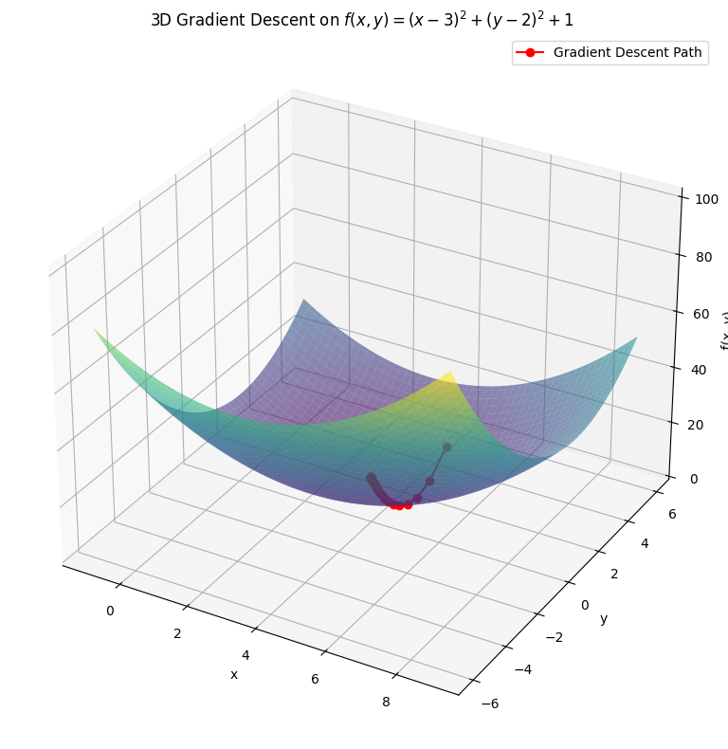

Slide 43
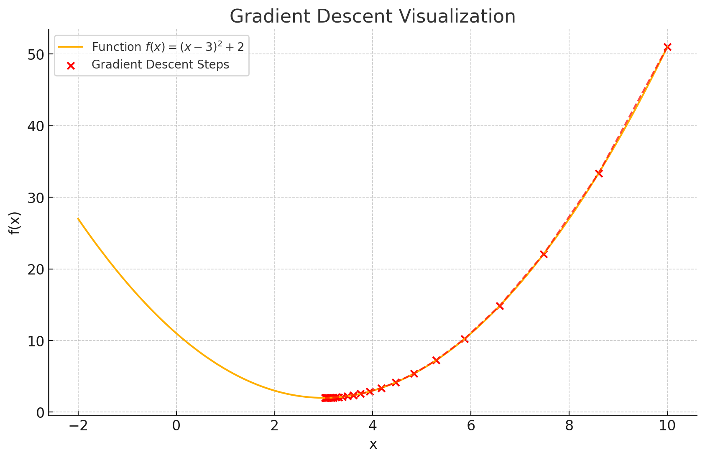

Slide 44
Feedforward Neural Networks
Information flows from input → output
Layers:
Input
Hidden (non-linear transforms)
Output
No cycles or feedback
Used in: classification, regression, embeddings

Slide 45
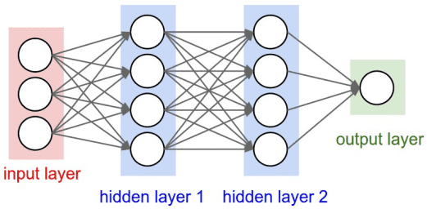
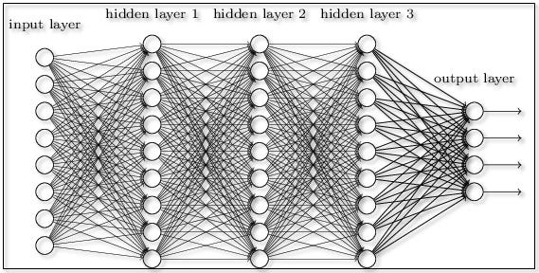
Feed Forward Neural Network
Feed Forward Deep Neural Network

Slide 46
Why Feed Forward Network
Function Approximation
Can approximate any continuous function (Universal Approximation Theorem).
Simplicity
Easy to implement and train. Great for structured data.
Foundation of Deep Learning
Core idea behind more advanced models (CNNs, RNNs, Transformers).

Slide 47
Feed Forward Network: Use Cases
Classification (e.g., spam detection)
Regression (e.g., price prediction)
Function learning (e.g., y=sin⁡(x))
Limitations:
No memory
Bad with images
Fixed Data size

Slide 48
Representation Power of Feedforward Neural Networks
With enough neurons/layers → approximate any function
Key factors:
Activation function (ReLU, Sigmoid, Tanh)
Network depth & width
Trade-off: accuracy vs. overfitting vs. computation

Slide 49
Summary
From logic gates to deep learning
Perceptrons paved the way
MLPs expanded expressive power
Gradient descent enabled learning
Feedforward NNs are foundational in modern AI

